Slide 1
Parameterized Algorithms The Basics
Insert «Academic unit» on every page: 1 Go to the menu «Insert» 2 Choose: Date and time 3 Write the name of your faculty or department in the field «Footer»
4 Choose «Apply to all"
Bart M. P. Jansen
August 18th 2014, Będlewo

Slide 2
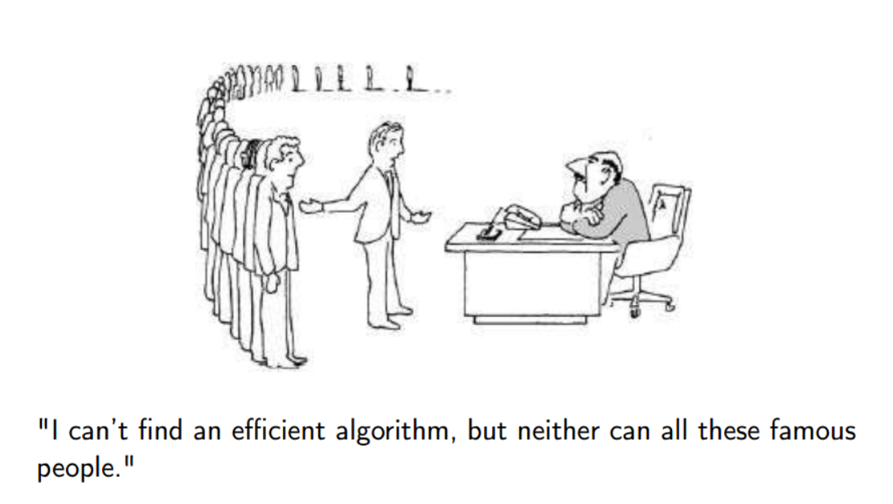
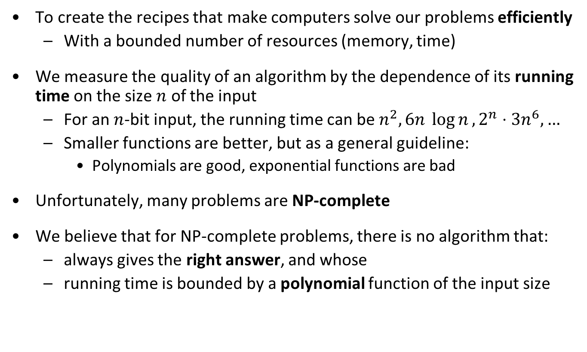
Why we are here
To create the recipes that make computers solve our problems efficiently
With a bounded number of resources (memory, time)
We measure the quality of an algorithm by the dependence of its running time on the size $n$ of the input
For an $n$-bit input, the running time can be $n^{2}, 6n \log{n}, 2^{n}⋅3n^{6},…$
Smaller functions are better, but as a general guideline:
Polynomials are good, exponential functions are bad
Unfortunately, many problems are NP-complete
We believe that for NP-complete problems, there is no algorithm that:
always gives the right answer, and whose
running time is bounded by a polynomial function of the input size

Slide 3
Dealing with NP-complete problems
Approximation
Sacrifice quality of the solution: quickly find a solution that is provably not very bad
Local search
Quickly find a solution for which you cannot give any quality guarantee (but which might often be good)
Branch & bound
Sacrifice running time guarantees: create an algorithm for which you do not know how long it will take (but which might do well on the inputs you use)
Parameterized algorithms
Sacrifice the running time: allow the running time to have an exponential factor, but ensure that the exponential dependence is not on the entire input size but just on some parameter that is hopefully small
Kernelization
Quickly shrink the input by preprocessing so that afterward running an exponential-time algorithm on the shrunk instance is fast enough

Slide 4
History of parameterized complexity
PCP Theorem
Downey & Fellows book
NP-completeness
Kernelization lower bounds
1940 1950 1960 1970 1980 1990 2000 2010 …
Będlewo
school
Matching algorithm
Parameterized(in)tractability
Graph Minors Theorem
Simplex algorithm
Planar Dominating Set kernel

Slide 6
This lecture
Fixed-parameter tractability
Kernelization algorithms
Vertex Cover
Feedback Vertex Set
Dynamic programming
Set Cover
Vertex Cover
Feedback Arc Set in Tournaments
Bounded-depth search trees

Slide 7
Fixed-parameter tractability

Slide 8
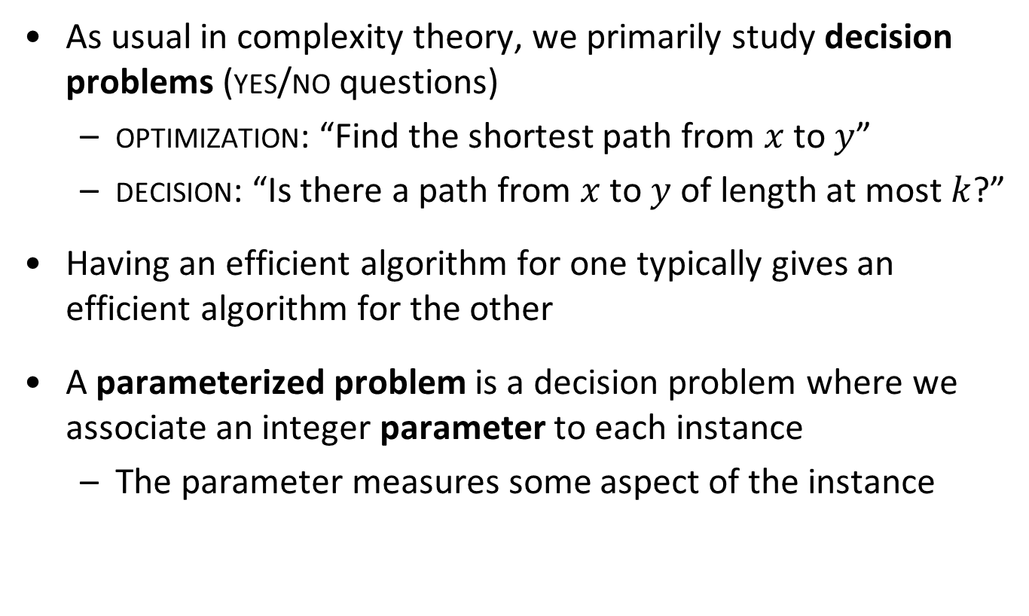
Parameterized problems
As usual in complexity theory, we primarily study decision problems (yes/no questions)
optimization: “Find the shortest path from $x$ to $y$”
decision: “Is there a path from $x$ to $y$ of length at most $k$?”
Having an efficient algorithm for one typically gives an efficient algorithm for the other
A parameterized problem is a decision problem where we associate an integer parameter to each instance
The parameter measures some aspect of the instance

Slide 9
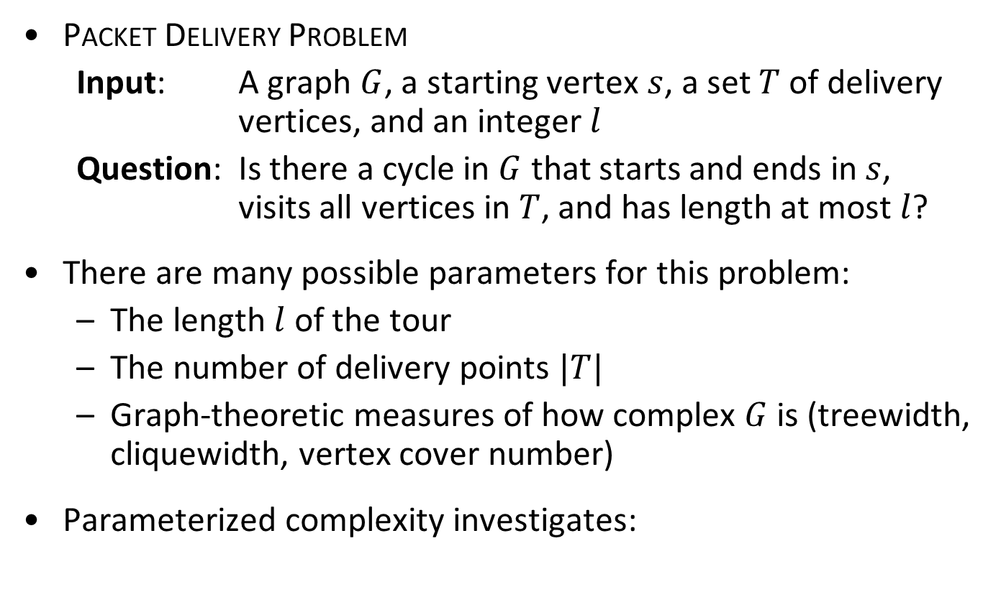
Problem parameterizations
Packet Delivery Problem
Input: A graph $G$, a starting vertex $s$, a set $T$ of delivery vertices, and an integer $l$
Question: Is there a cycle in $G$ that starts and ends in $s$, visits all vertices in $T$, and has length at most $l$?
There are many possible parameters for this problem:
The length $l$ of the tour
The number of delivery points $|T|$
Graph-theoretic measures of how complex $G$ is (treewidth, cliquewidth, vertex cover number)
Parameterized complexity investigates:
Can the problem be solved efficiently, if the parameter is small?

Slide 10
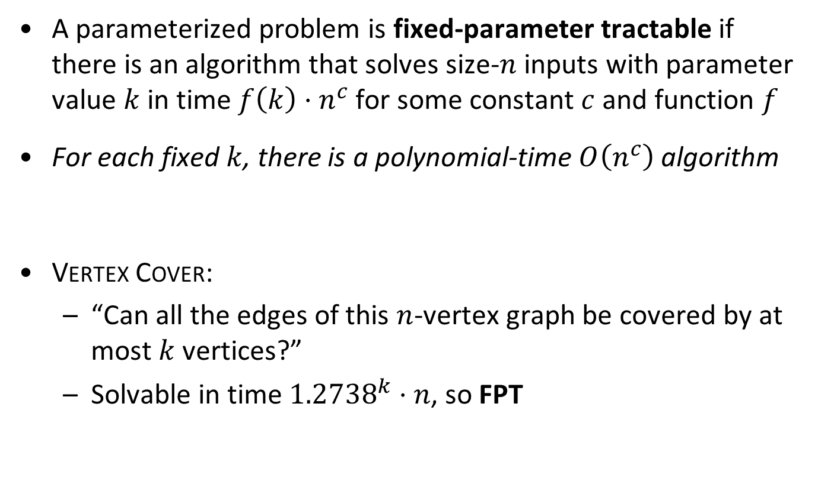
Fixed-parameter tractability – informally
A parameterized problem is fixed-parameter tractable if there is an algorithm that solves size-$n$ inputs with parameter value $k$ in time $f\left(k\right)⋅n^{c}$ for some constant $c$ and function $f$
For each fixed $k$, there is a polynomial-time $O\left(n^{c}\right)$ algorithm
Vertex Cover:
“Can all the edges of this $n$-vertex graph be covered by at most $k$ vertices?”
Solvable in time ${1.2738}^{k}⋅n$, so FPT

Slide 11
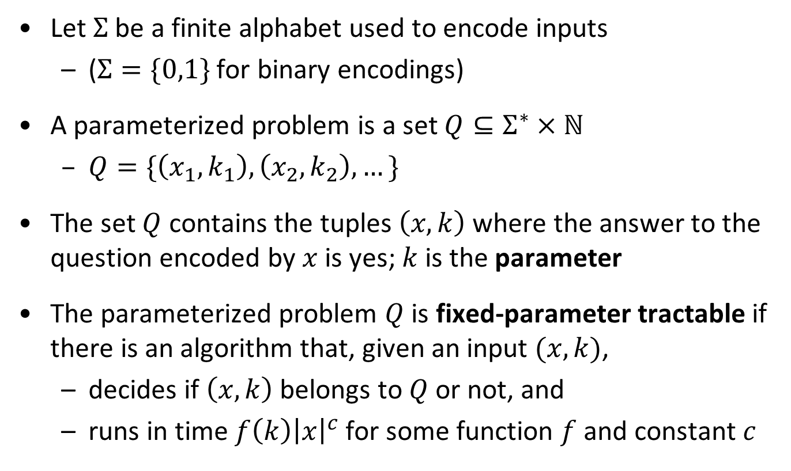
Fixed-parameter tractability – formally
Let $Σ$ be a finite alphabet used to encode inputs
($Σ=\{0,1\}$ for binary encodings)
A parameterized problem is a set $Q⊆Σ^{∗}×ℕ$
$Q=\{\left(x_{1},k_{1}\right), \left(x_{2},k_{2}\right), …\}$
The set $Q$ contains the tuples $\left(x,k\right)$ where the answer to the question encoded by $x$ is yes; $k$ is the parameter
The parameterized problem $Q$ is fixed-parameter tractable if there is an algorithm that, given an input $(x,k)$,
decides if $\left(x,k\right)$ belongs to $Q$ or not, and
runs in time $f\left(k\right){\left|x\right|}^{c}$ for some function $f$ and constant $c$

Slide 12
kernelization

Slide 13
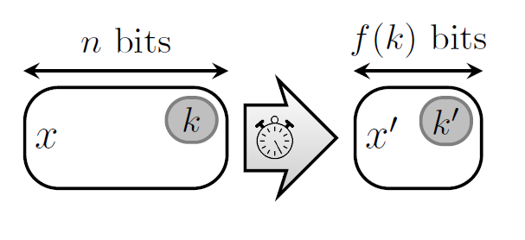
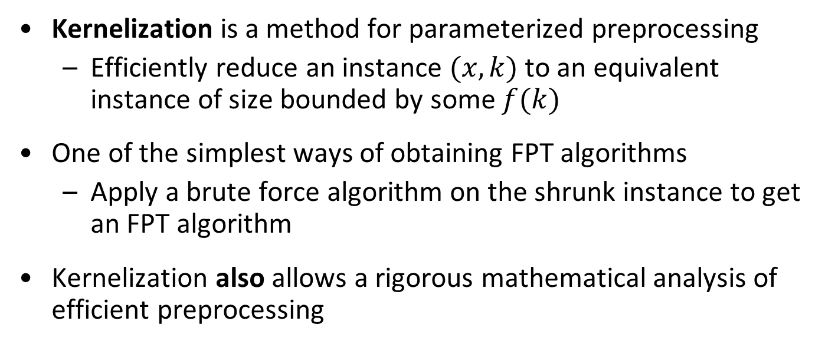
Data reduction with a guarantee
Kernelization is a method for parameterized preprocessing
Efficiently reduce an instance $(x,k)$ to an equivalent instance of size bounded by some $f(k)$
One of the simplest ways of obtaining FPT algorithms
Apply a brute force algorithm on the shrunk instance to get an FPT algorithm
Kernelization also allows a rigorous mathematical analysis of efficient preprocessing
Notes:
Let’s look at an example before giving the formal definition

Slide 14
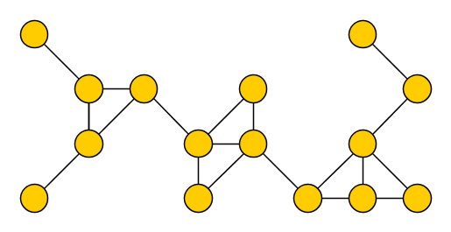
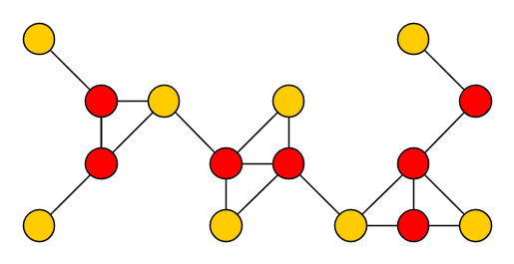
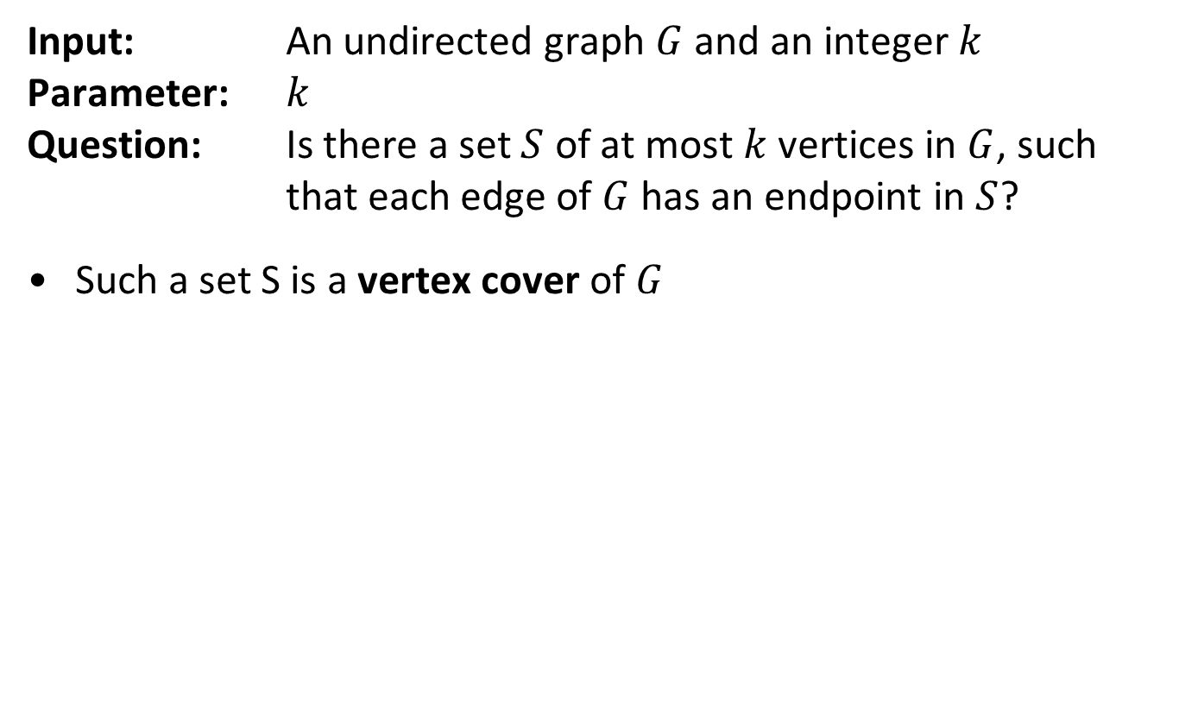
The Vertex Cover problem
Input: An undirected graph $G$ and an integer $k$ Parameter: $k$ Question: Is there a set $S$ of at most $k$ vertices in $G$, such that each edge of $G$ has an endpoint in $S$?
Such a set S is a vertex cover of $G$

Slide 15
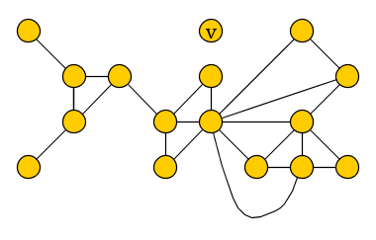
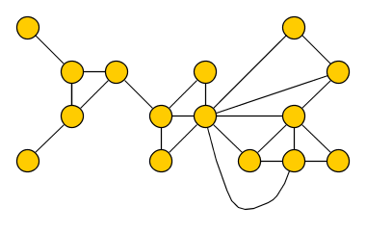
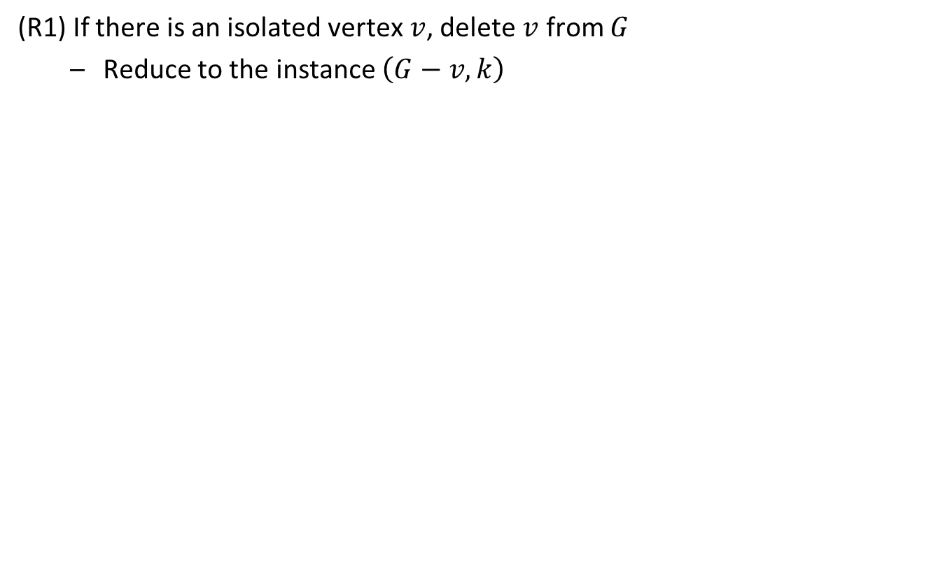
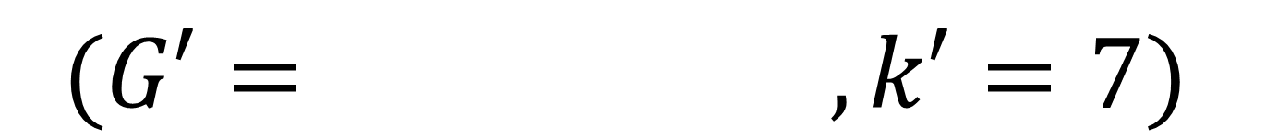
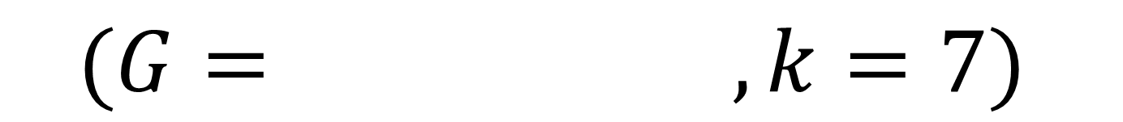
Reduction rules for Vertex Cover – (R1)
(R1) If there is an isolated vertex $v$, delete $v$ from $G$
Reduce to the instance $\left(G−v,k\right)$
$$(G= , k=7)$$
$$(G′= , k′=7)$$

Slide 16
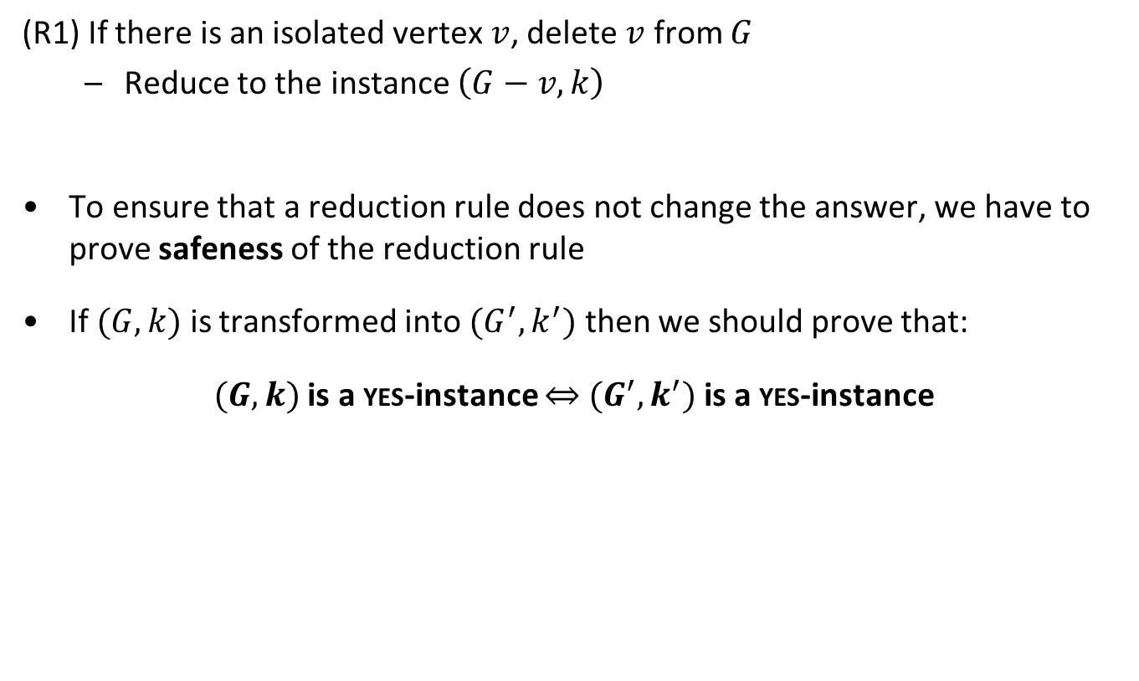
Reduction rules for Vertex Cover – (R1)
(R1) If there is an isolated vertex $v$, delete $v$ from $G$
Reduce to the instance $\left(G−v,k\right)$
To ensure that a reduction rule does not change the answer, we have to prove safeness of the reduction rule
If $(G,k)$ is transformed into $(G^{′},k^{′})$ then we should prove that:
$(G,k)$ is a yes-instance $⇔$ $(G^{′},k^{′})$ is a yes-instance

Slide 17
Reduction rules for Vertex Cover – (R1)
(R1) If there is an isolated vertex $v$, delete $v$ from $G$
Reduce to the instance $\left(G−v,k\right)$
$$(G= , k=7)$$
$$(G′= , k′=7)$$

Slide 18
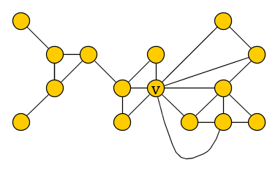
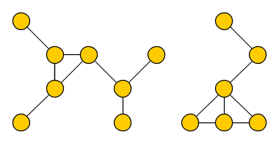
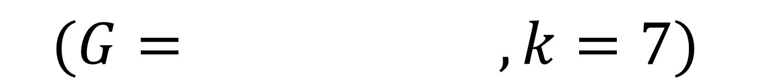
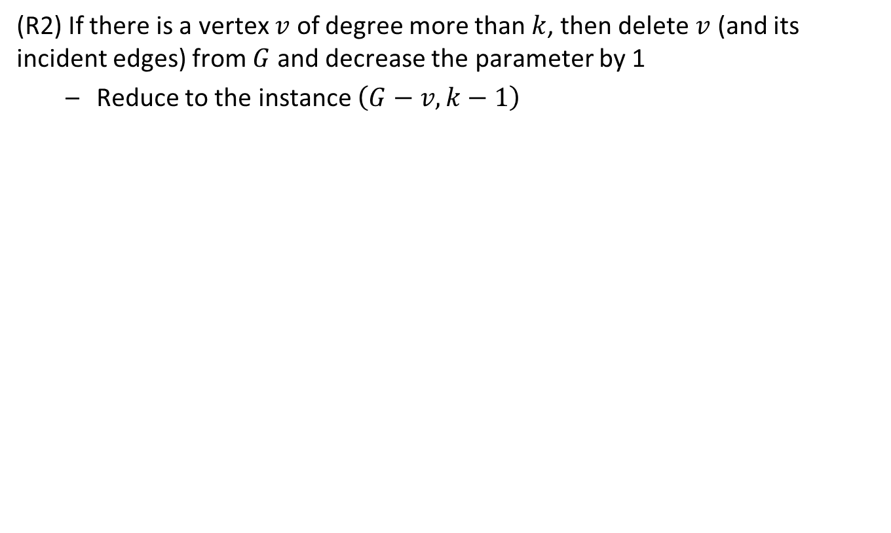
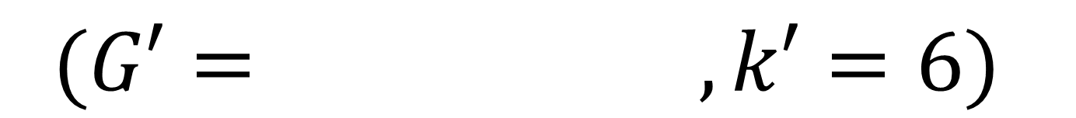
Reduction rules for Vertex Cover – (R2)
(R2) If there is a vertex $v$ of degree more than $k$, then delete $v$ (and its incident edges) from $G$ and decrease the parameter by 1
Reduce to the instance $\left(G−v,k−1\right)$
$$(G= , k=7)$$
$$(G′= , k′=6)$$

Slide 19
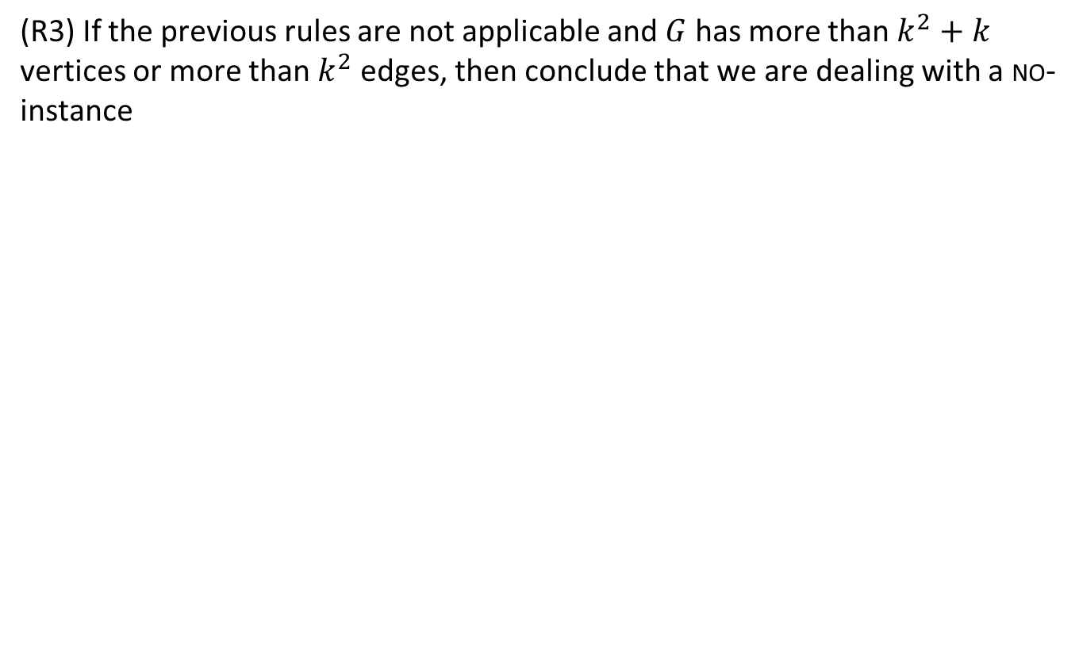
Reduction rules for Vertex Cover – (R3)
(R3) If the previous rules are not applicable and $G$ has more than $k^{2}+k$ vertices or more than $k^{2}$ edges, then conclude that we are dealing with a no-instance

Slide 20
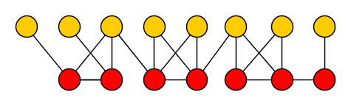
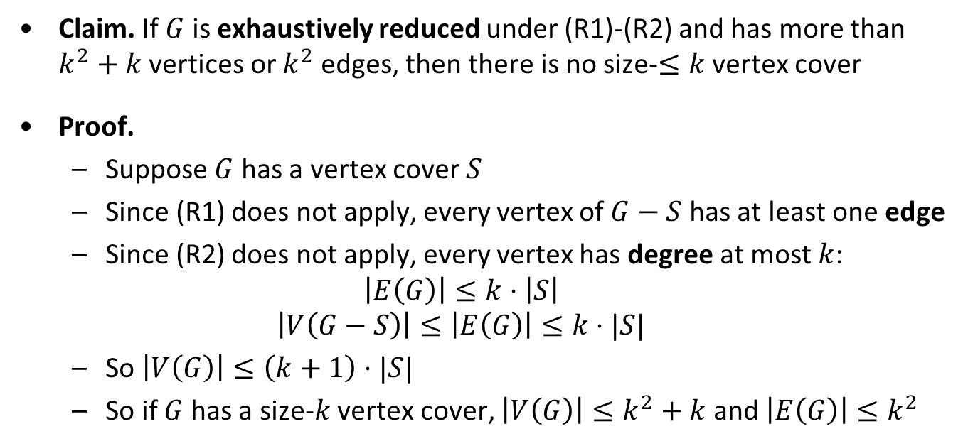
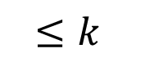
Correctness of the cutoff rule
Claim. If $G$ is exhaustively reduced under (R1)-(R2) and has more than $k^{2}+k$ vertices or $k^{2}$ edges, then there is no size-$≤k$ vertex cover
Proof.
Suppose $G$ has a vertex cover $S$
Since (R1) does not apply, every vertex of $G−S$ has at least one edge
Since (R2) does not apply, every vertex has degree at most $k$:
$$\left|E\left(G\right)\right|≤k⋅\left|S\right|$$
$$\left|V\left(G−S\right)\right|≤\left|E\left(G\right)\right|≤k⋅|S|$$
So $\left|V\left(G\right)\right|≤\left(k+1\right)⋅|S|$
So if $G$ has a size-$k$ vertex cover, $\left|V\left(G\right)\right|≤k^{2}+k$ and $\left|E\left(G\right)\right|≤k^{2}$
S
$$≤k$$

Slide 21
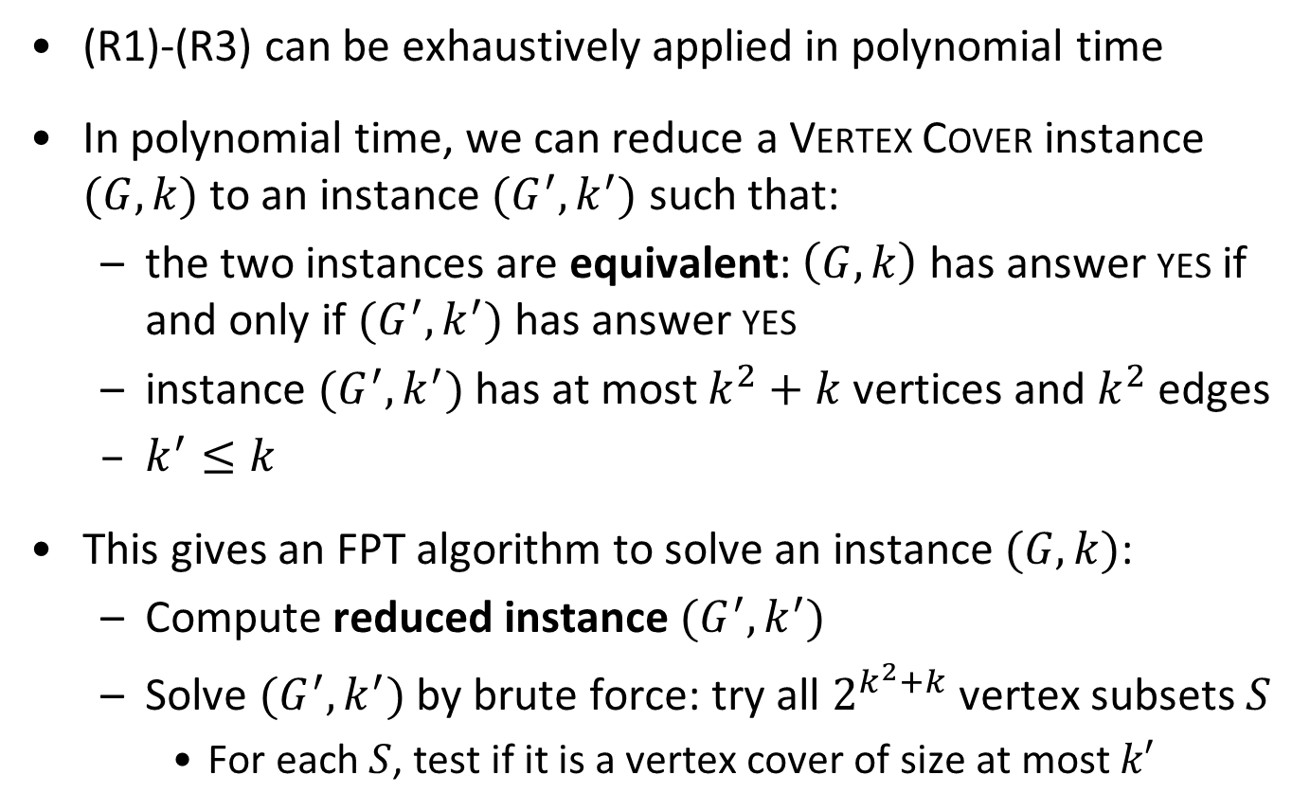
Preprocessing for Vertex Cover
(R1)-(R3) can be exhaustively applied in polynomial time
In polynomial time, we can reduce a Vertex Cover instance $(G,k)$ to an instance $(G^{′},k^{′})$ such that:
the two instances are equivalent: $\left(G,k\right)$ has answer yes if and only if $(G^{′},k^{′})$ has answer yes
instance $(G^{′},k^{′})$ has at most $k^{2}+k$ vertices and $k^{2}$ edges
$k^{′}≤k$
This gives an FPT algorithm to solve an instance $(G,k)$:
Compute reduced instance $(G^{′},k^{′})$
Solve $(G^{′},k^{′})$ by brute force: try all $2^{k^{2}+k}$ vertex subsets $S$
For each $S$, test if it is a vertex cover of size at most $k′$
Theorem. $k$-Vertex Cover is fixed-parameter tractable

Slide 22
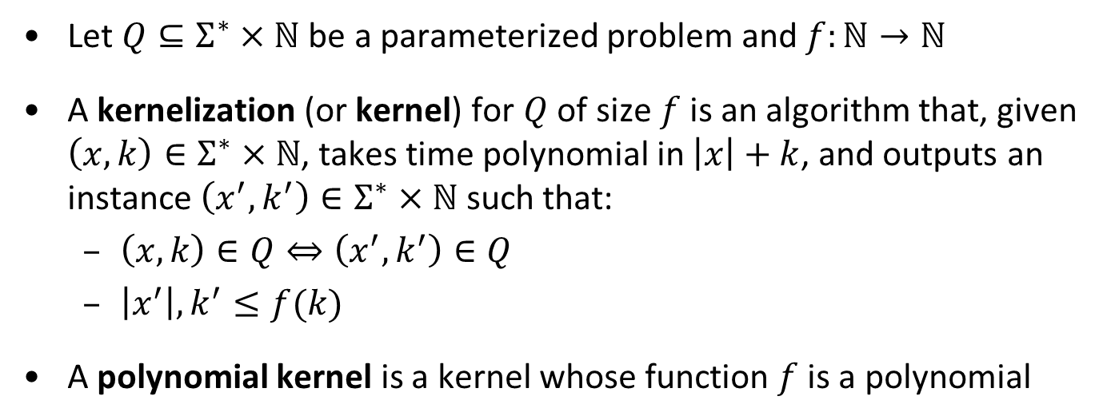
Kernelization – formally
Let $Q⊆Σ^{∗}×ℕ$ be a parameterized problem and $f:ℕ→ℕ$
A kernelization (or kernel) for $Q$ of size $f$ is an algorithm that, given $\left(x,k\right)∈Σ^{∗}×ℕ$, takes time polynomial in $\left|x\right|+k$, and outputs an instance $\left(x^{′},k^{′}\right)∈Σ^{∗}×ℕ$ such that:
$\left(x,k\right)∈Q⇔\left(x^{′},k^{′}\right)∈Q$
$\left|x^{′}\right|,k^{′}≤f(k)$
A polynomial kernel is a kernel whose function $f$ is a polynomial
Theorem. A parameterized problem is fixed-parameter tractable if and only if it is decidable and has a kernel (of arbitrary size)

Slide 23
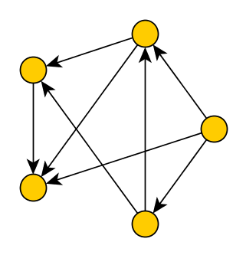
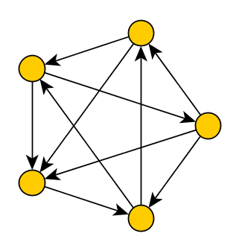
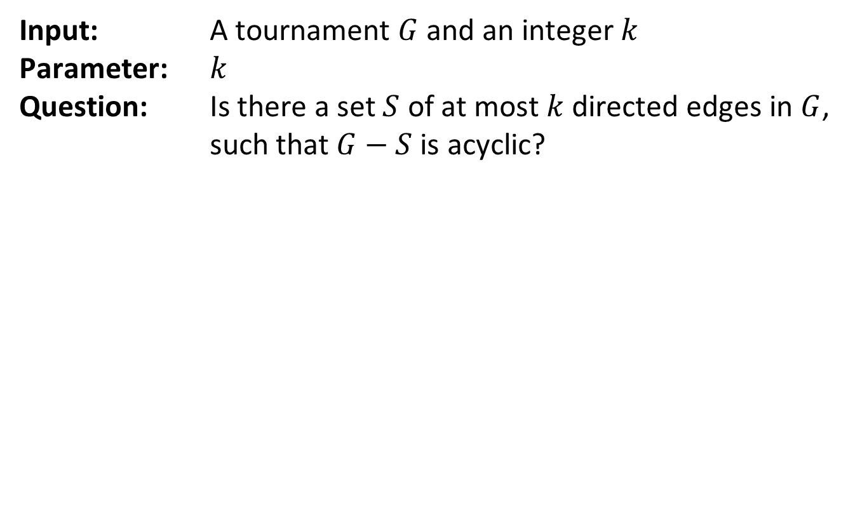
Kernel for Feedback Arc Set in Tournaments
Input: A tournament $G$ and an integer $k$ Parameter: $k$ Question: Is there a set $S$ of at most $k$ directed edges in $G$, such that $G−S$ is acyclic?

Slide 24
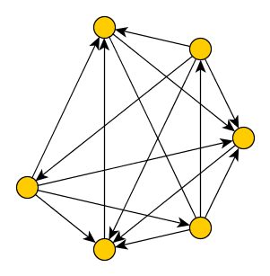
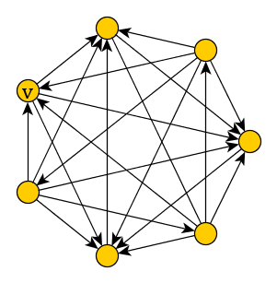
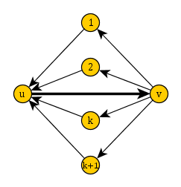
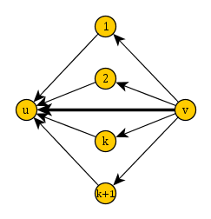
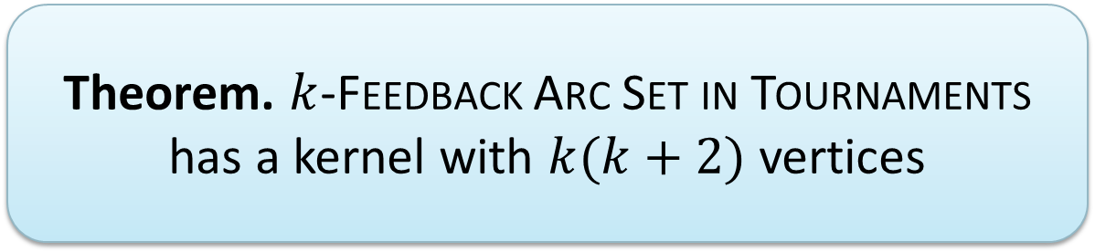
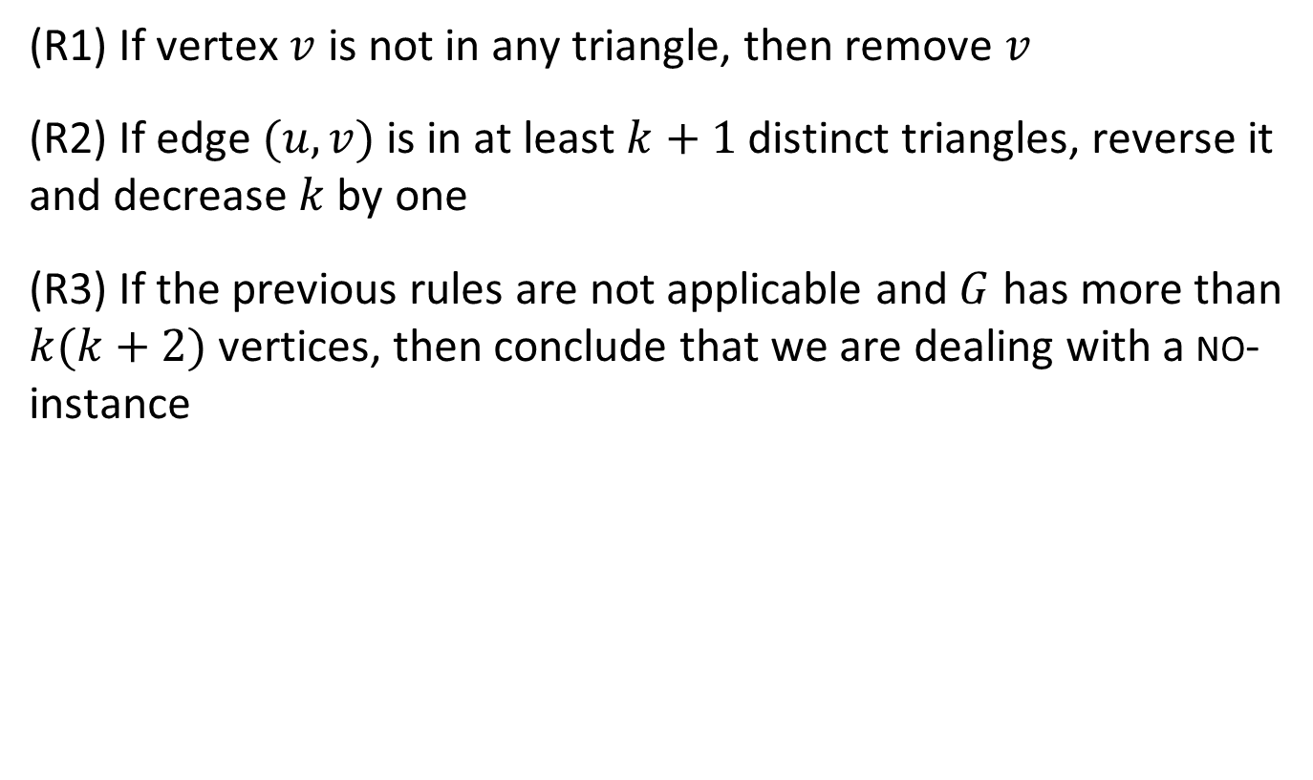
Reduction rules for Feedback Arc Set
(R1) If vertex $v$ is not in any triangle, then remove $v$
(R2) If edge $(u,v)$ is in at least $k+1$ distinct triangles, reverse it and decrease $k$ by one
(R3) If the previous rules are not applicable and $G$ has more than $k(k+2)$ vertices, then conclude that we are dealing with a no-instance
Theorem. $k$-Feedback Arc Set in Tournaments has a kernel with $k(k+2)$ vertices

Slide 25
High-level kernelization strategy
Compare to Vertex Cover:
(R1) deals with elements that do not constrain the solution
(R2) deals with elements that must be in any solution
(R3) deals with graphs that remain large after reduction

Slide 26
Bounded-depth search trees

Slide 27
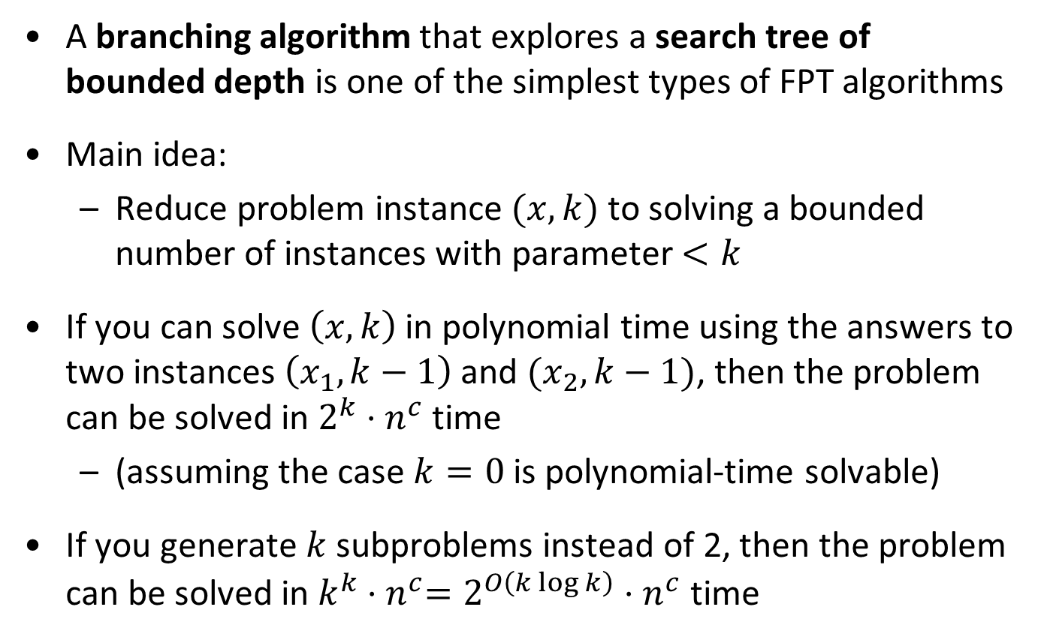
Background
A branching algorithm that explores a search tree of bounded depth is one of the simplest types of FPT algorithms
Main idea:
Reduce problem instance $(x,k)$ to solving a bounded number of instances with parameter $<k$
If you can solve $\left(x,k\right)$ in polynomial time using the answers to two instances $\left(x_{1},k−1\right)$ and $(x_{2},k−1)$, then the problem can be solved in $2^{k}⋅n^{c}$ time
(assuming the case $k=0$ is polynomial-time solvable)
If you generate $k$ subproblems instead of 2, then the problem can be solved in $k^{k}{⋅n}^{c}=2^{O\left(k\log{k}\right)}⋅n^{c}$ time

Slide 28
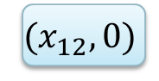
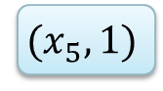
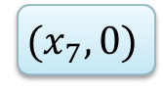
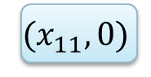
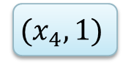
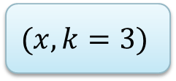
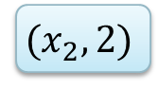
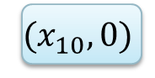

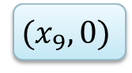
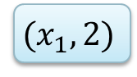


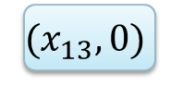
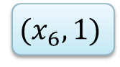
A search tree
$$(x,k=3)$$
$$(x_{1},2)$$
$$(x_{2},2)$$
$$(x_{3},1)$$
$$(x_{4},1)$$
$$(x_{5},1)$$
$$(x_{6},1)$$
$$(x_{7},0)$$
$$(x_{8},0)$$
$$(x_{9},0)$$
$$(x_{10},0)$$
$$(x_{11},0)$$
$$(x_{12},0)$$
$$(x_{13},0)$$
$$(x_{14},0)$$

Slide 29


Analysis of bounded-depth search trees
If the parameter decreases for each recursive call, the depth of the tree is at most $k$
# nodes in a depth-$d$ tree with $l$ leaves is $O(l⋅d)$
Usually sufficient to bound the number of leaves
If the computation in each node takes polynomial time, total running time is $O(l⋅d⋅n^{c})$

Slide 30



Vertex Cover revisited
Input: A graph $G$ and an integer $k$ Parameter: $k$ Question: Is there a set $S$ of at most $k$ vertices in $G$, such that each edge has an endpoint in $S$?

Slide 31

Algorithm for Vertex Cover
Algorithm VC(Graph $G$, integer $k$)
if $k<0$ then return no
if $G$ has no edges then return yes
else pick an edge in $G$ and let $u$ and $v$ be its endpoints
return (VC$(G–u, k−1)$ or (VC$(G−v, k−1)$)
Correct because any vertex cover must use $u$ or $v$
A size-$k$ vertex cover in G that uses $u$, yields a size-$(k−1)$ vertex cover in $G−u$

Slide 32

Running time for Vertex Cover
Every iteration either solves the problem directly or makes two recursive calls with a decreased parameter
The branching factor of the algorithm–and therefore of the search tree–is two
Tree of depth $k$ with branching factor $2$ has at most $2^{k}$ leaves
Running time is $2^{k}⋅n^{c}$
Much better than $2^{k^{2}+k}$ from the kernelization algorithm
One way to faster algorithms:
Pick a vertex $v$ of maximum degree, recurse on
$(G−v, k−1)$ and $(G −N\left(v\right), k −d\left(v\right))$

Slide 33




The Feedback Vertex Set problem
Input: An undirected (multi)graph $G$ and an integer $k$ Parameter: $k$ Question: Is there a set $S$ of at most $k$ vertices in $G$, such that each cycle contains a vertex of $S$?
We allow multiple edges and self-loops
Such a set $S$ is a feedback vertex set of $G$
Removing $S$ from $G$ results in an acyclic graph, a forest

Slide 34

Branching for Feedback Vertex Set
For Vertex Cover, we could easily identify a set of vertices to branch on: the two endpoints of an edge
For feedback vertex set, a solution may not contain any endpoint of an edge
How should we branch?
We will find a set $S$ of $O(k)$ vertices such that any size-$k$ feedback vertex set contains a vertex of $S$
To find $S$ we first have to simplify the graph using reduction rules that do not change the answer

Slide 35

























Reduction rules
(R1) If there is a loop at vertex $v$, then delete $v$ and decrease $k$ by one
(R2) If there is an edge of multiplicity larger than $2$, then reduce its multiplicity to $2$
(R3) If there is a vertex $v$ of degree at most $1$, then delete $v$
(R4) If there is a vertex $v$ of degree two, then delete $v$ and add an edge between $v$’s neighbors
If (R1-R4) cannot be applied anymore, then the minimum degree is at least $3$
Observation. If $\left(G,k\right)$ is transformed into $(G^{′},k^{′})$, then:
fvs of size $≤k$ in $G⇔$ fvs of size $≤k′$ in $G′$
Any feedback vertex set in $G′$ is a feedback vertex set in $G$ when combined with the vertices deleted by (R1)

Slide 36

Identifying a set to branch on
Let $G$ be a graph whose vertices have degree three or more
Order the vertices as $v_{1}, v_{2}, … , v_{n}$ by decreasing degree
Let $V_{3k}≔\{v_{1},…, v_{3k}\}$ be the $3k$ largest-degree vertices
Lemma. If all vertices of $G$ have degree 3 or more, then any size-$≤k$ feedback vertex set of $G$ contains a vertex from $V_{3k}$
So if there is a size-$≤k$ solution, it contains a vertex of $V_{3k}$
For each $v∈V_{3k}$ recurse on the instance $(G−v,k−1)$
Gives an algorithm with running time ${\left(3k\right)}^{k}⋅n^{c}$
Apply the reduction rules, compute $V_{3k}$, then branch

Slide 37

A useful claim
Claim. If $X$ is a feedback vertex set of $G$, then $\sum_{v∈X}{\left(d\left(v\right)−1\right)≥\left|E\left(G\right)\right|−\left|V\left(G\right)\right|+1}$
Proof. Graph $F :=G –X$ is a forest
So $\left|E\left(F\right)\right|≤\left|V\left(F\right)\right|−1=|V(G)|−|X|−1$
Every edge not in $F$, is incident with a vertex of $X$ $\sum_{v∈X}{d(v)}+\left|V\left(G\right)\right|−\left|X\right|− 1≥|E(G)|$
With this claim, we can prove the degree lemma

Slide 38

Proving the degree lemma
Lemma. If all vertices of $G$ have degree 3 or more, then any size-$≤k$ feedback vertex set of G contains a vertex from $V_{3k}$
Proof by contradiction.
Let $X$ be a size-$≤k$ feedback vertex set with $X∩V_{3k}=∅$
By choice of $V_{3k}$ we have: $\min_{v∈V_{3k}}{d(v)≥\max_{v∈X}{d\left(v\right)}}$, so:
$$\sum_{v∈V_{3k}}{\left(d\left(v\right)−1\right)≥3⋅\sum_{v∈X}{\left(d\left(v\right)−1\right)}≥3⋅\left(\left|E\left(G\right)\right|−\left|V\left(G\right)\right|+1\right).}$$
Define $V^{+}≔V\left(G\right)∖V_{3k}$. Since $X⊆V^{+}$:
$$\sum_{v∈V^{+}}{(d\left(v\right)−1)}≥\sum_{v∈X}{\left(d\left(v\right)−1\right)}≥\left|E\left(G\right)\right|−\left|V\left(G\right)\right|+1 \\ \sum_{v∈V\left(G\right)}{\left(d\left(v\right)−1\right)≥}4⋅\left(\left|E\left(G\right)\right|−\left|V\left(G\right)\right|+1\right).$$
By the previous claim

Slide 39

Proving the degree lemma (II)
$\sum_{v∈V\left(G\right)}{\left(d\left(v\right)−1\right)≥}4⋅\left(\left|E\left(G\right)\right|−\left|V\left(G\right)\right|+1\right)$
The degree sum counts every edge twice: $\sum_{v∈V\left(G\right)}{d\left(v\right)}=2⋅|E(G)|$
Combining these: $4⋅\left(\left|E\left(G\right)\right|−\left|V\left(G\right)\right|+1\right)≤\sum_{v∈V\left(G\right)}{\left(d\left(v\right)−1\right)}=2⋅\left|E\left(G\right)\right|−|V\left(G\right)|$
So $2⋅\left|E\left(G\right)\right|<3⋅|V\left(G\right)|$
But since all vertices have degree $≥3$ we have: $2⋅\left|E\left(G\right)\right|=\sum_{v∈V\left(G\right)}{d\left(v\right)}≥3⋅\left|V\left(G\right)\right|,$
Contradiction

Slide 40

A final word on bounded-depth search trees
The degree lemma proves the correctness of our branching strategy for Feedback Vertex Set
When building a branching algorithm for a parameterization by the solution size:
Find an $f(k)$-size set that contains a vertex of the solution
Branch in $f(k)$ directions, trying all possibilities
We get a search tree of depth $k$ and branching factor $f(k)$
You can think of the branching process as guessing

Slide 41
Dynamic programming

Slide 42






The Set Cover problem
Input: A set family $ℱ$ over a universe $U$ and an integer $k$ Parameter: $|U|$ Question: Is there a subfamily $ℱ^{′}⊆ℱ$ of at most $k$ sets, such that $\bigcup_{F∈ℱ′}{F}=U?$
The subfamily $ℱ′$ covers the universe $U$
Set Cover parameterized by the universe size is FPT
Algorithm with running time $2^{\left|U\right|}⋅{\left(\left|U\right|+\left|ℱ\right|\right)}^{c}$
Based on dynamic programming
$$F_{2}$$
$$F_{3}$$
$$F_{1}$$
$$F_{4}$$

Slide 43

Dynamic programming for Set Cover
Let $ℱ=\{F_{1},F_{2},…,F_{m}\}$
We define a DP table for $X⊆U$ and $j∈\{0,1,…, m\}$
$T\left[X,j\right]$ = min nr. of sets from $F_{1},…, F_{j}$ needed to cover $X$
Or $+∞$ if impossible
The value $T[U,m]$ gives the minimum size of a set cover
To solve the problem, compute $T$ using base cases and a recurrence

Slide 44

Filling the dynamic programming table
$T\left[X,j\right]$ = min nr. of sets from $F_{1},…, F_{j}$ needed to cover $X$
Base case: $j=0$
$T\left[X,j\right]=0$ if $X=∅$, otherwise it is $+∞$
Recursive step: $j>0$
$$T\left[X,j\right]=min⁡(T\left[X,j−1\right],1+T\left[X\backslash F_{j},j−1\right])$$
Skip set $F_{j}$, or pay for $F_{j}$ and afterwards cover $X\backslash F_{j}$
Each entry can be computed in polynomial time
$(\left|ℱ\right|+1)⋅2^{\left|U\right|}$ entries in total

Slide 45

More on dynamic programming
Dynamic programming is a memory-intensive algorithmic paradigm that yields FPT algorithms in various situations
Here: dynamic programming over subsets of $U$
Later: dynamic programming over tree decompositions
Research challenge:
Determine whether the $2^{\left|U\right|}$ factor can be improved to ${\left(2−ε\right)}^{\left|U\right|}$ for some $ε>0$

Slide 46
Exercises
2.4, 2.7, 2.9, 2.14
Kernelization
Branching
3.2, 3.4, 3.7, 3.8
Dynamic programming
6.2
From this lecture ..
Prove the safeness that the reduction rules for Feedback Arc Set in tournaments are safe
Improve the running time of the Vertex Cover branching algorithm to ${1.6181}^{k}$
Improve the running time of the Vertex Cover branching algorithm to 〖1.6181〗^𝑘

Slide 47
Summary
Parameterized algorithmics is a young, vibrant research area that investigates how to cope with NP-completeness
We saw three ways of building FPT algorithms:
Kernelization
Bounded-depth search trees
Dynamic programming over subsets

Slide 48
The end

